Slide 1

3D Modeling
Tutor : Liyan Chen
Email: chenliyan@xmu.edu.cn

Slide 2
Chapter 4
Modeling Foundation

Slide 3

Section 1. The Concept of Modeling
In a broad sense, modeling is like sculpture with different tools and materials. MAYA provides us with a virtual space and tools, We can clearly gather basic units of 3D , vertex, edge and face together to form a model.

Slide 4
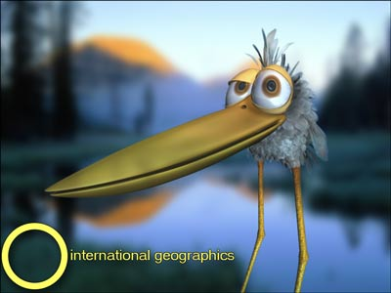
Why do we model?
In the animation, there are two basic purposes to model:
*For Vision
*For Animation

Slide 5
Section 2. The Ideas of 3D Modeling
There are kinds of Modeling technologies and methods, but they can generally be classified as three kinds that suit lots of things. What's more, it provides you with a more efficient way to think and help you to analyze, conclude and sum up the rules of modeling.
* Inductive Method
* Cross-section Method
* Skin Method

Slide 6
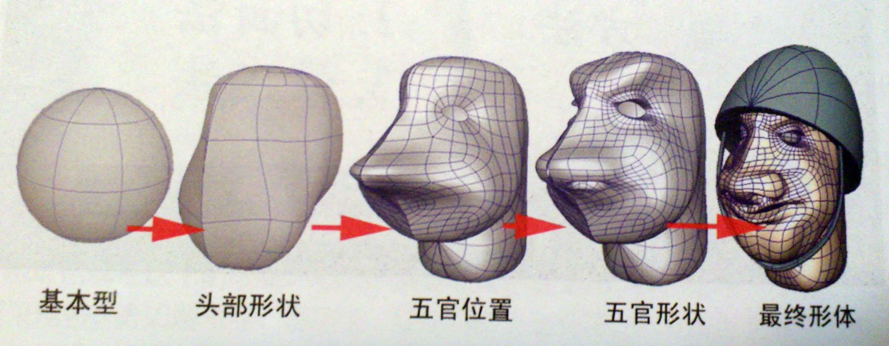
* Inductive Method
We treat geometry as the basic form, add and adjust the position and quantity of vertices and faces according to the specific needs, then form what we eventually want.

Slide 7
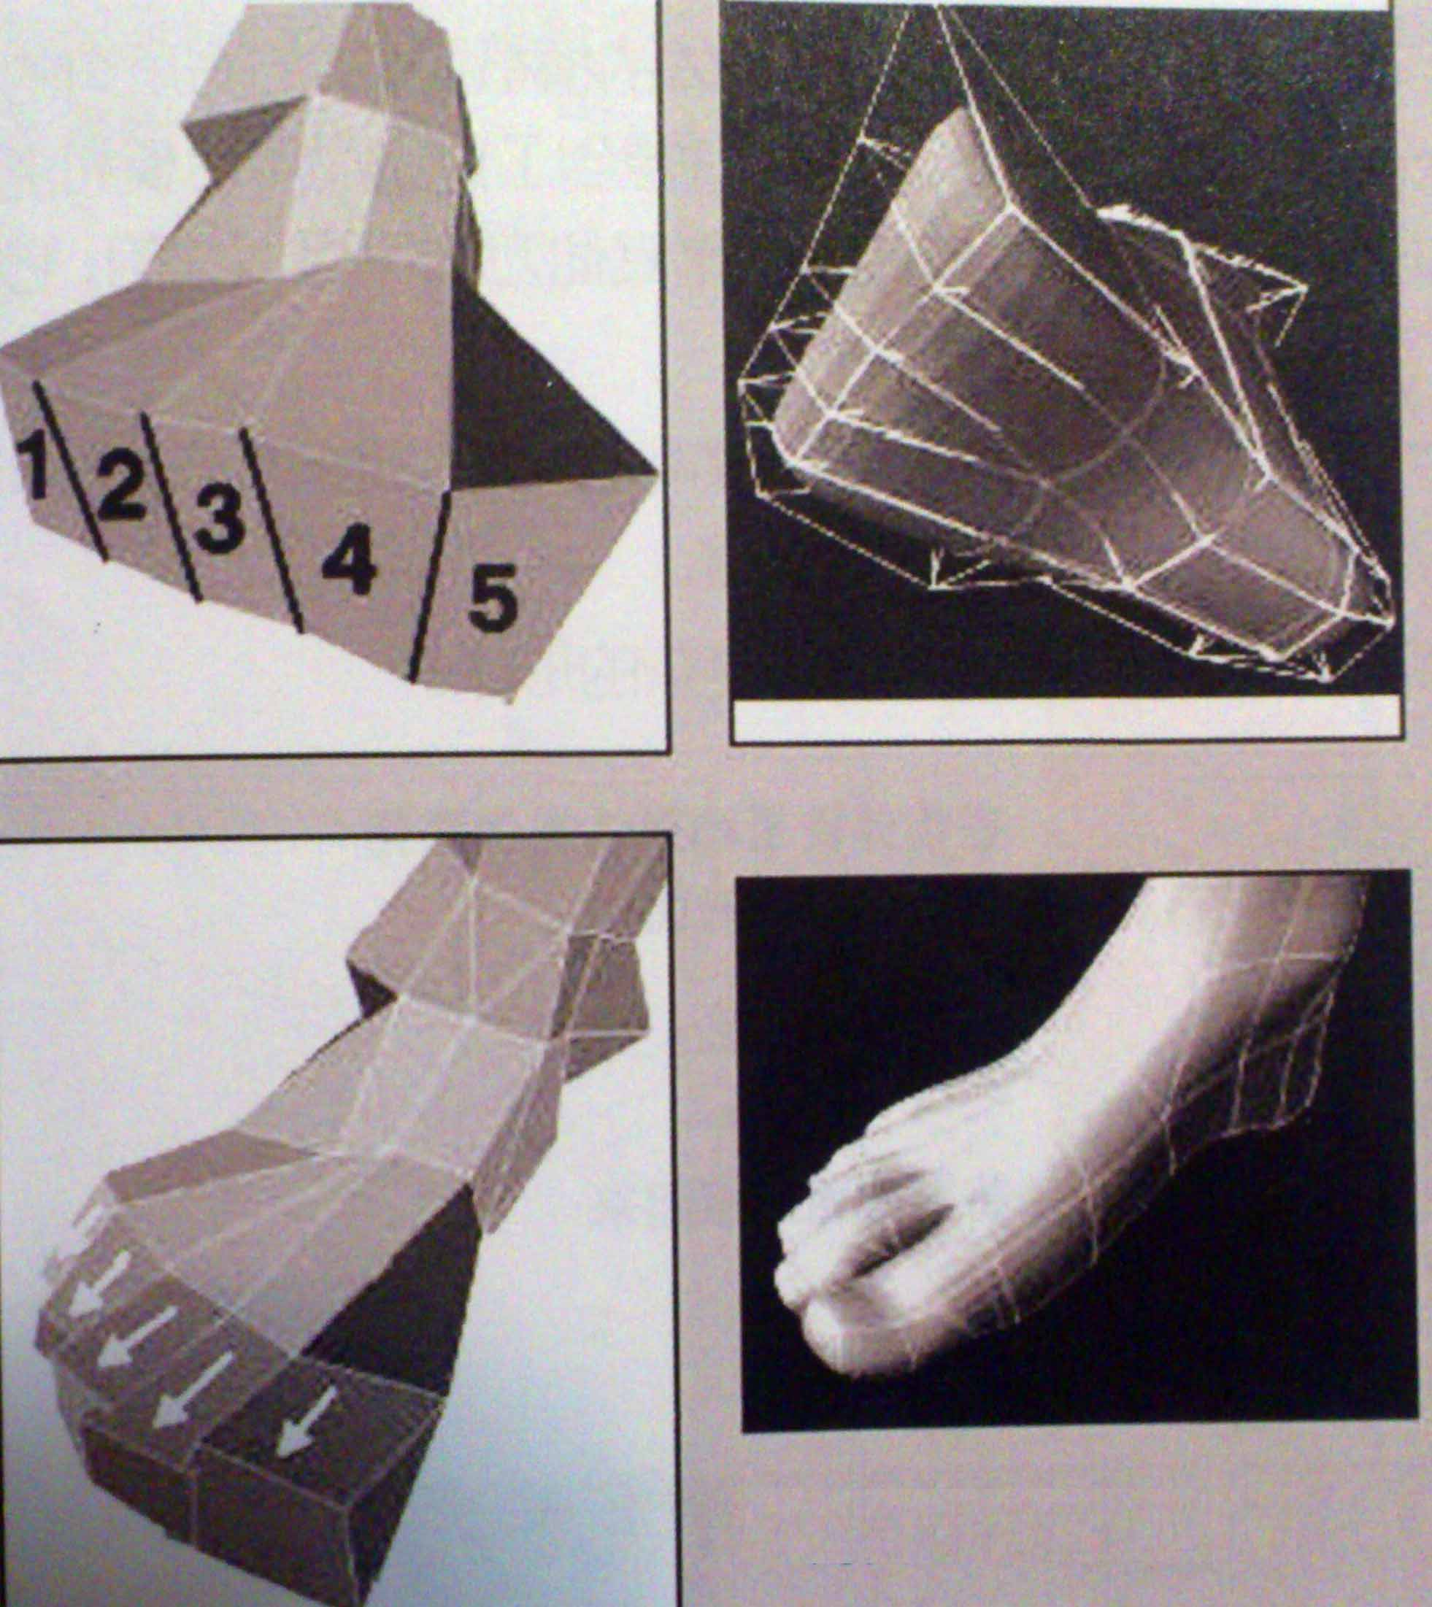

Slide 8

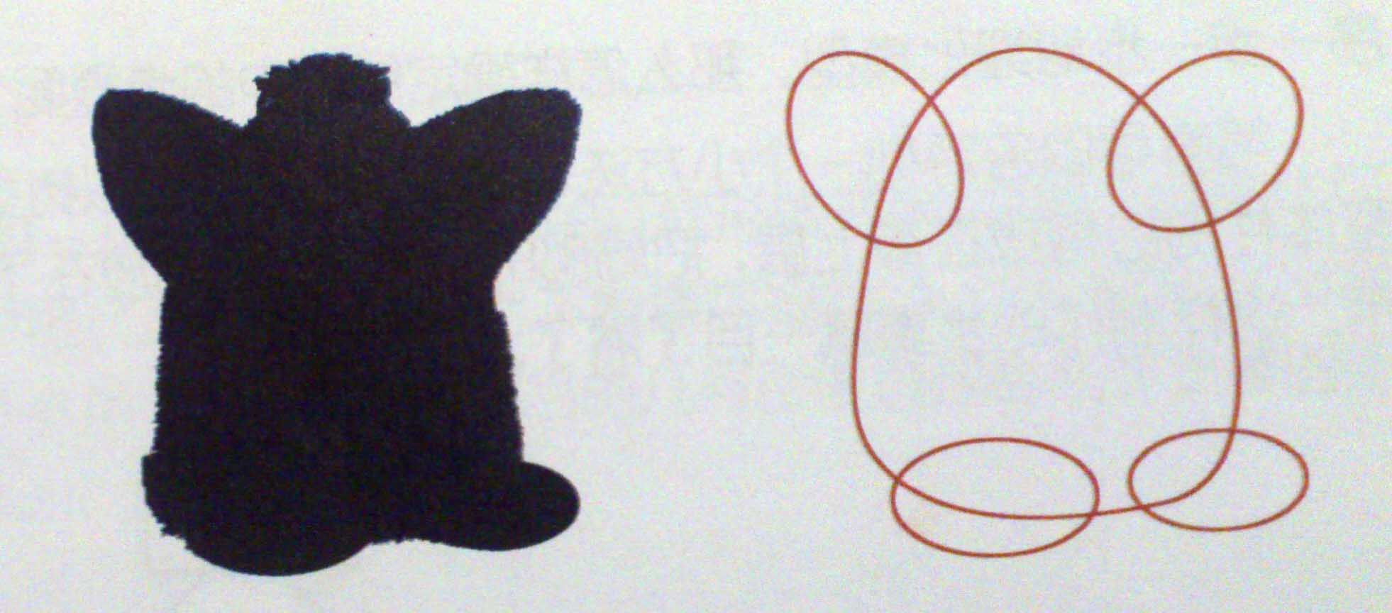
How To Conclude Forms?
Method 1: Ignore the internal structure of the object, only to see its outer contour, then the outline is the basic form of objects.

Slide 9
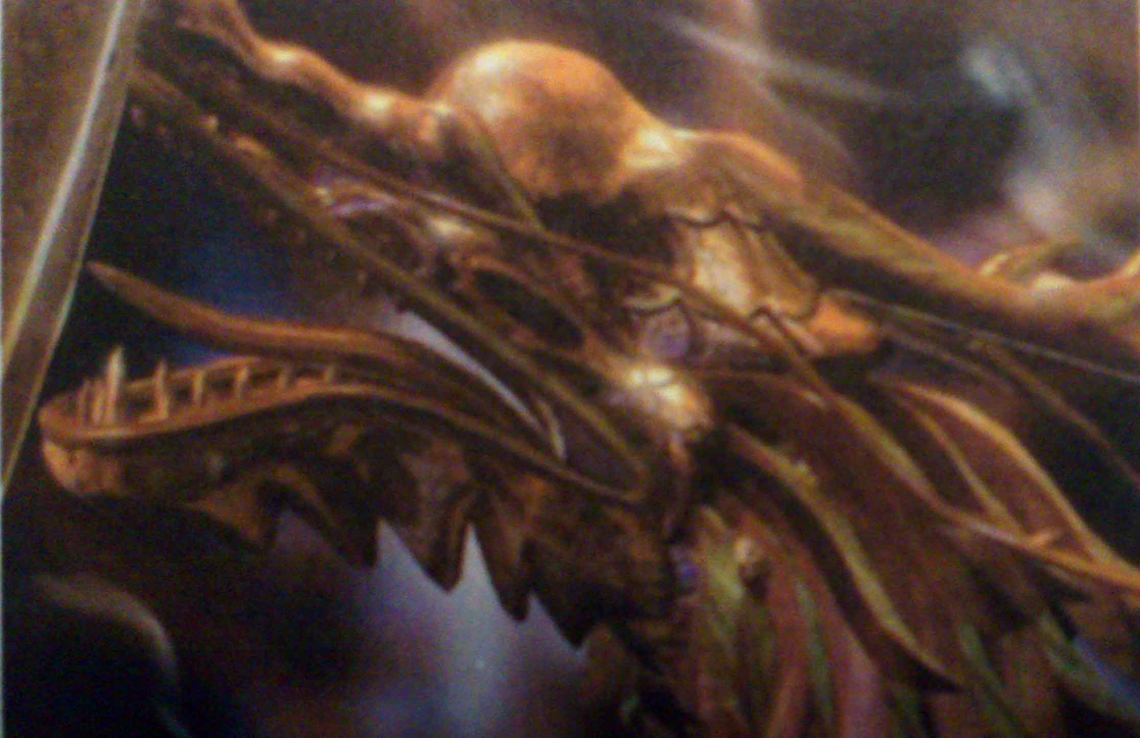
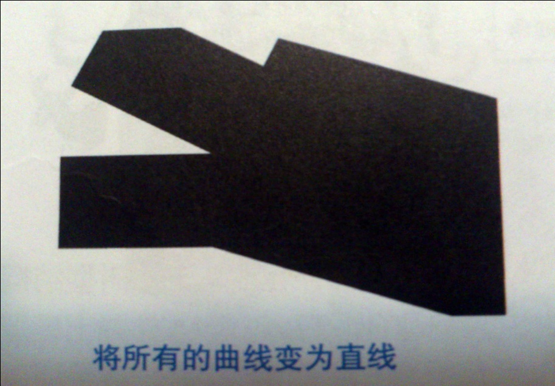
How To Conclude Forms?
Method 2: Change the curve into a straight line. Many objects can’t be changed to basic forms on account of complex outlines. And we just need to find out two points connecting two curves and change it to a straight line then combine them as a whole straight line.

Slide 10
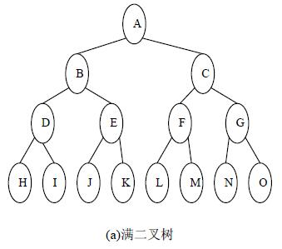
How To Conclude Forms?
Method 3：Set up a tree structure chart to make sure of production steps, then put the inclusive, global structure on the top and put the local, detailed one in the lower level to form a tree structure. Finally, everthing come out clearly.

Slide 11
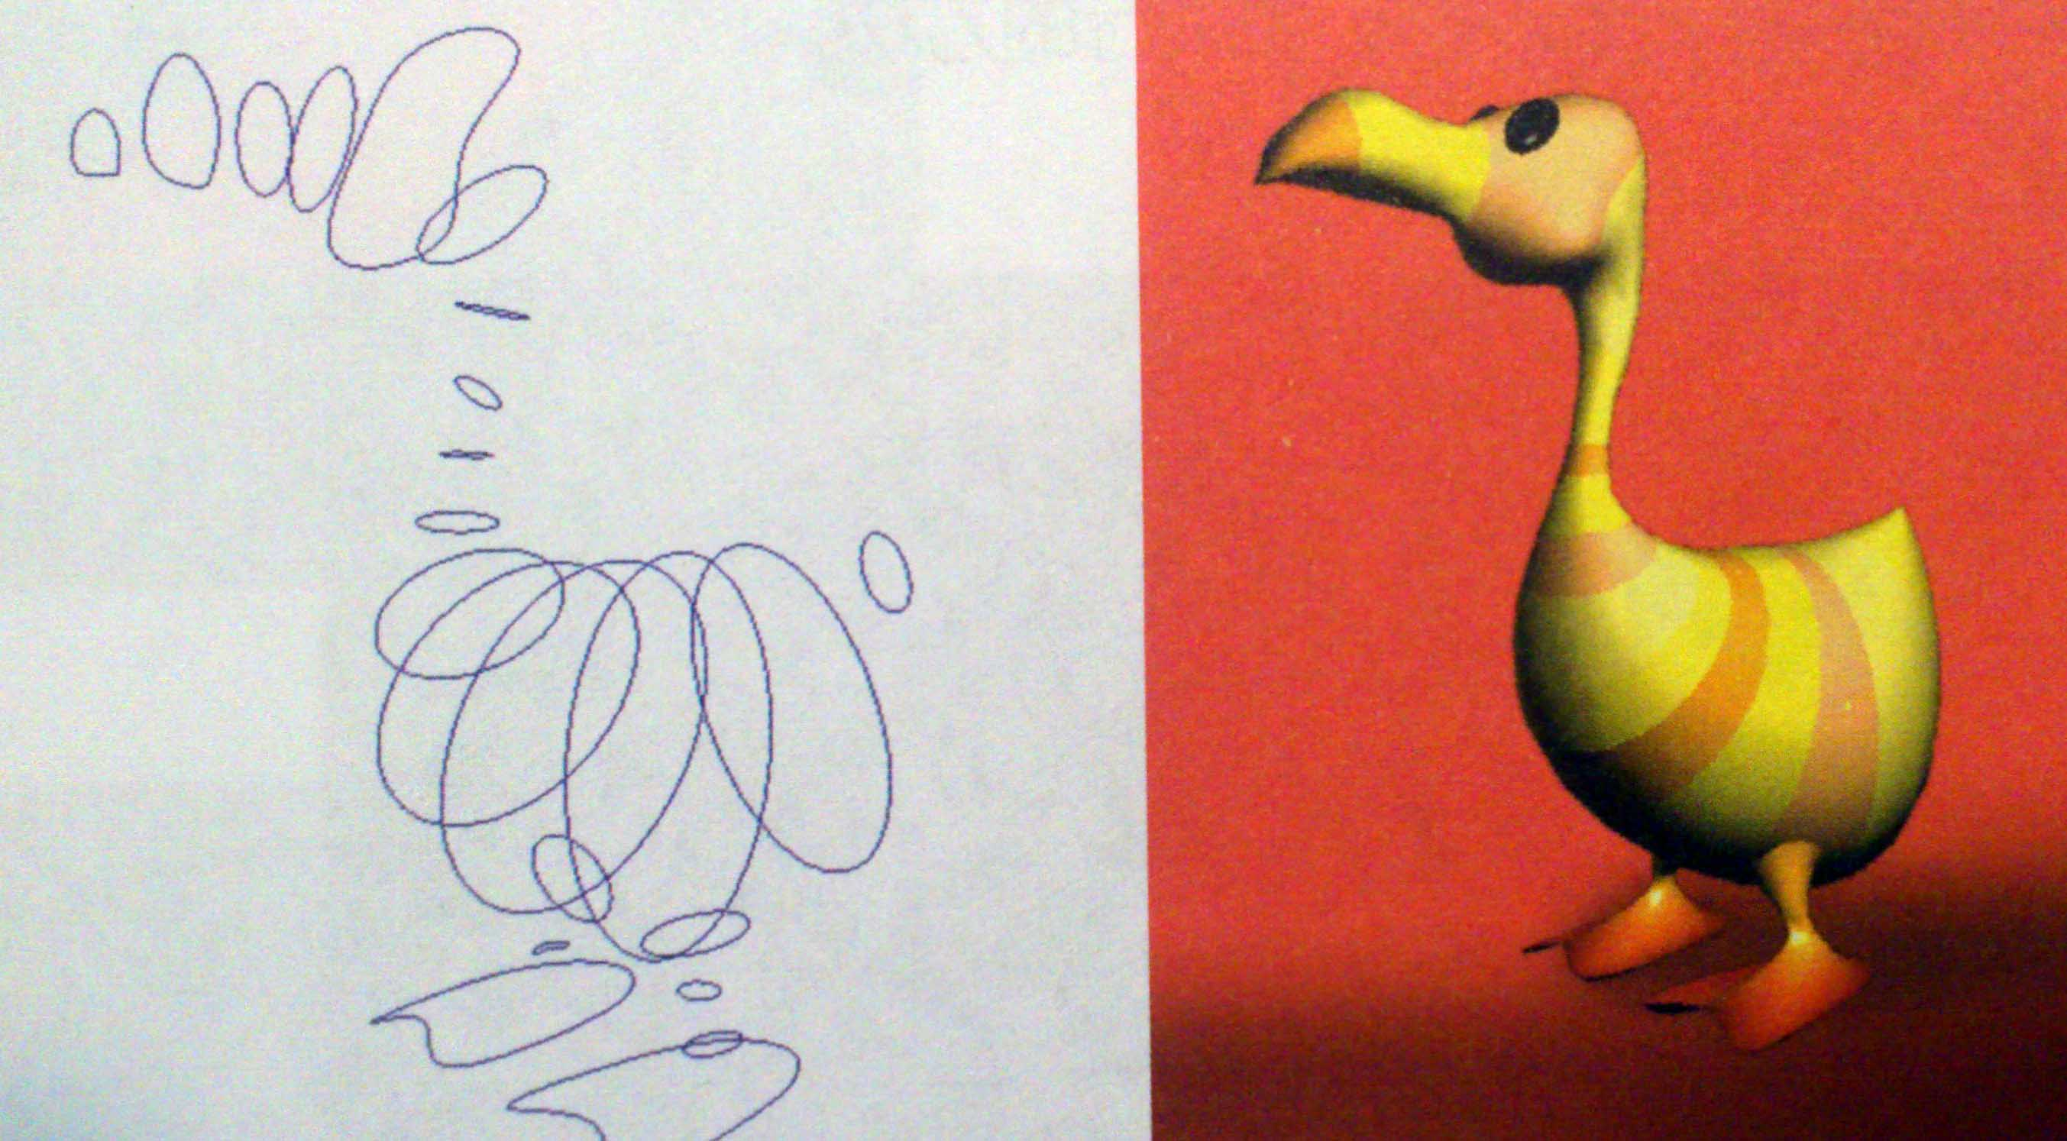
*Cross-section Method
We can divide models like cutting bread. At first, use lines to draw cross sections of it. Secondly, connect all the cross sections in a certain way.

Slide 12
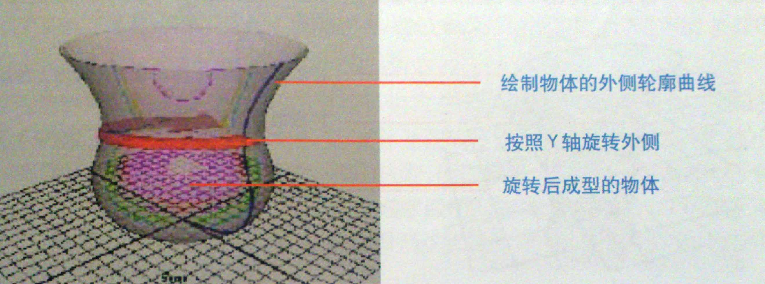
How To Cut Faces？
Method 1：After drawing the outer edge of the object, we can rotate it to be a surface, which suits for all cylindrical shapes and related changes.

Slide 13
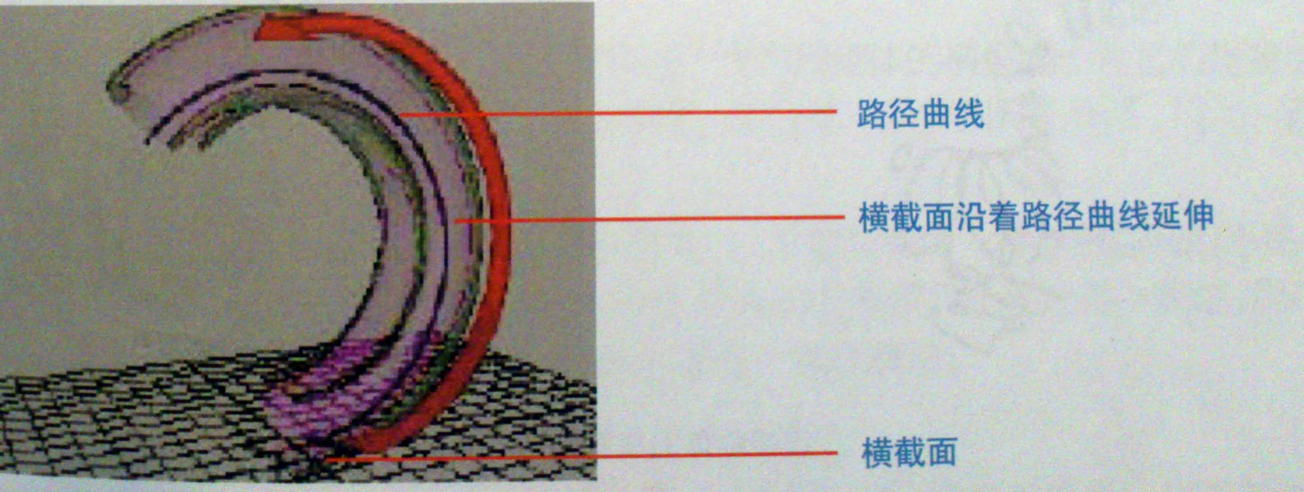
How To Cut Faces？
Method 2：Draw cross sections and one curve as a path, to make the former go along with the latter to form a surface.

Slide 14
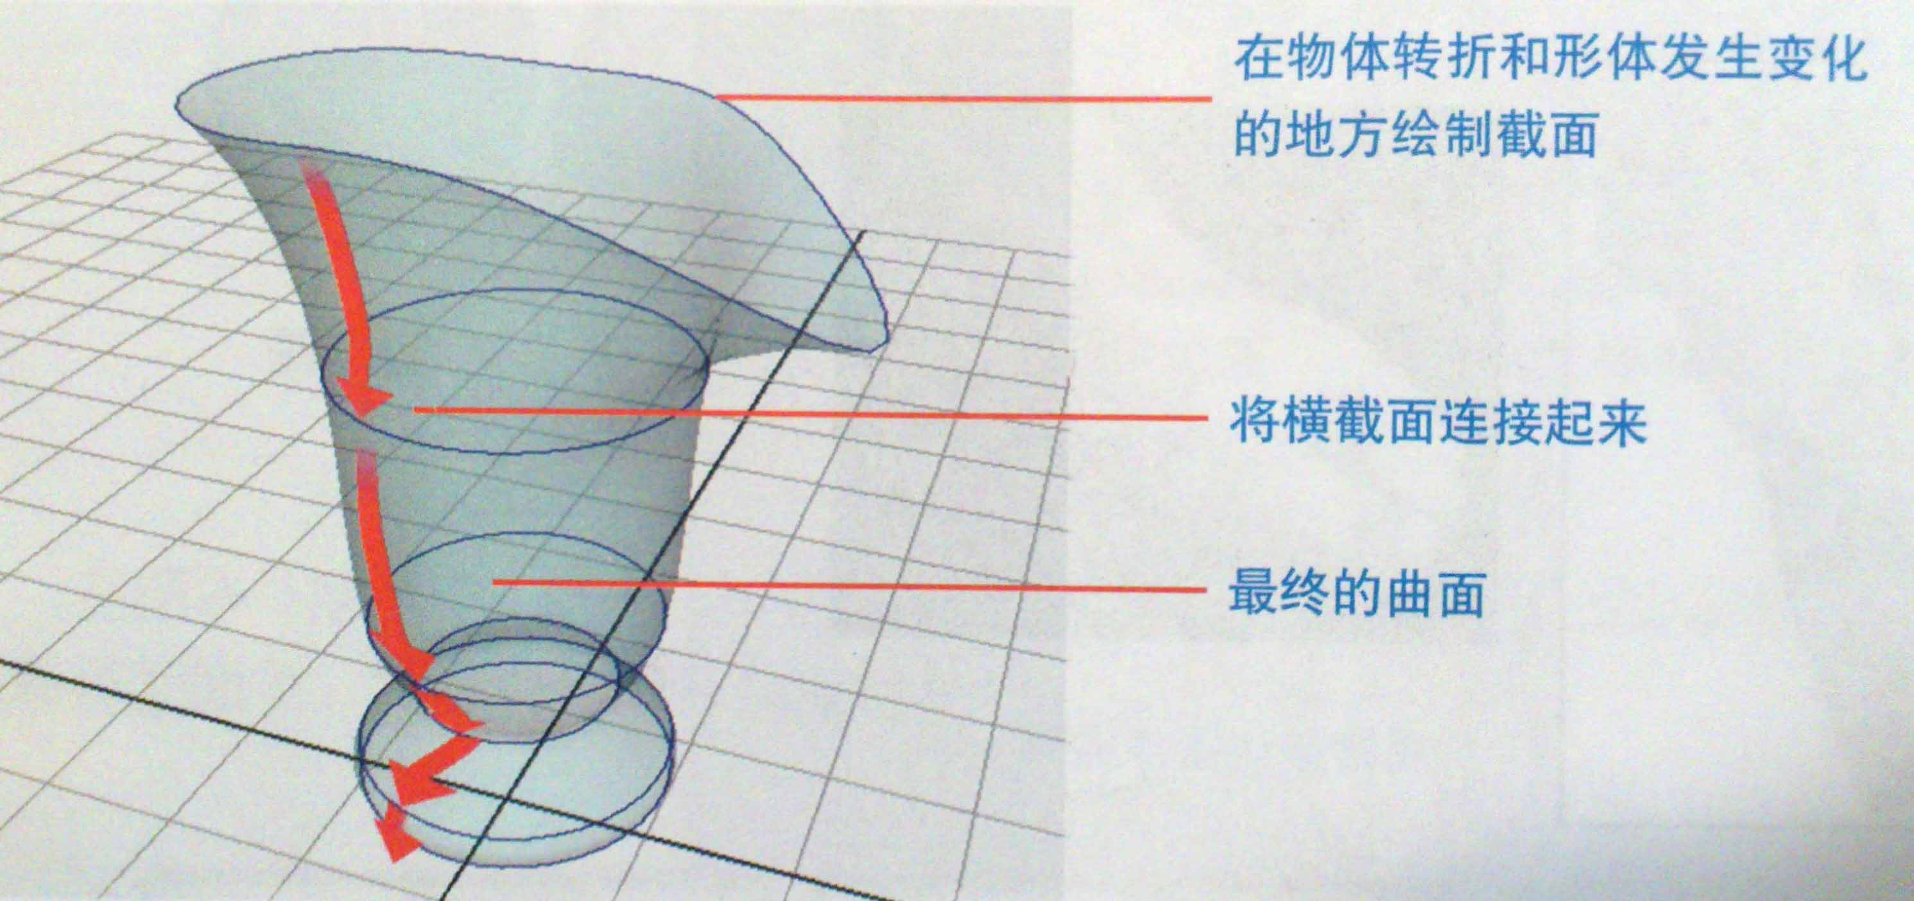
How To Cut Faces？
Method 3：Draw cross sections that lie in changed places, and connect those together to form surfaces.

Slide 15
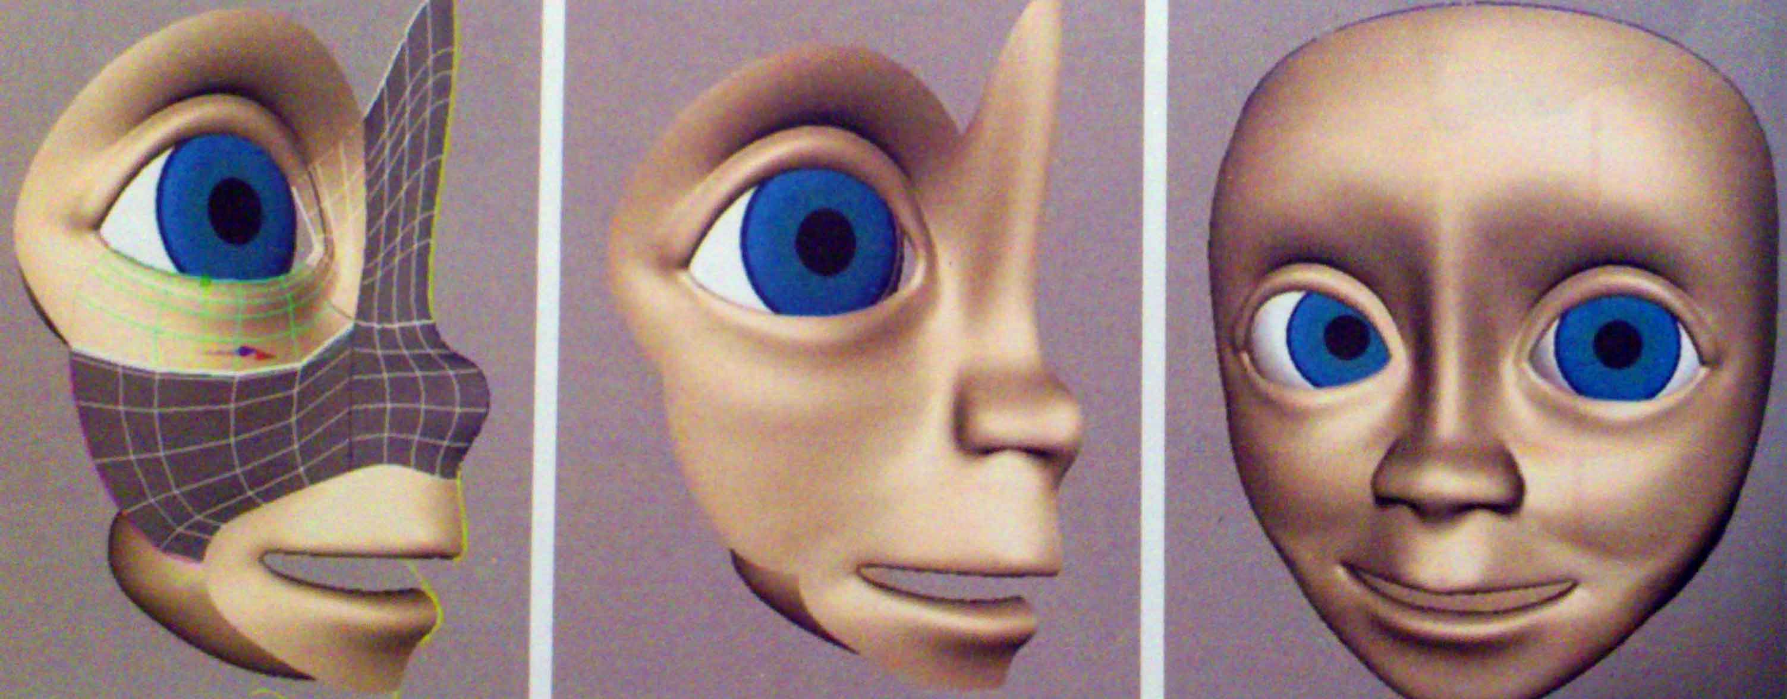
*Skin Method
Use lines to sketch the outline of tailored solutions like making clothes, which will finally form surfaces and shape a whole object. During production with the skin method, model precision is extremely high due to the lines strictly based on animation design.

Slide 16
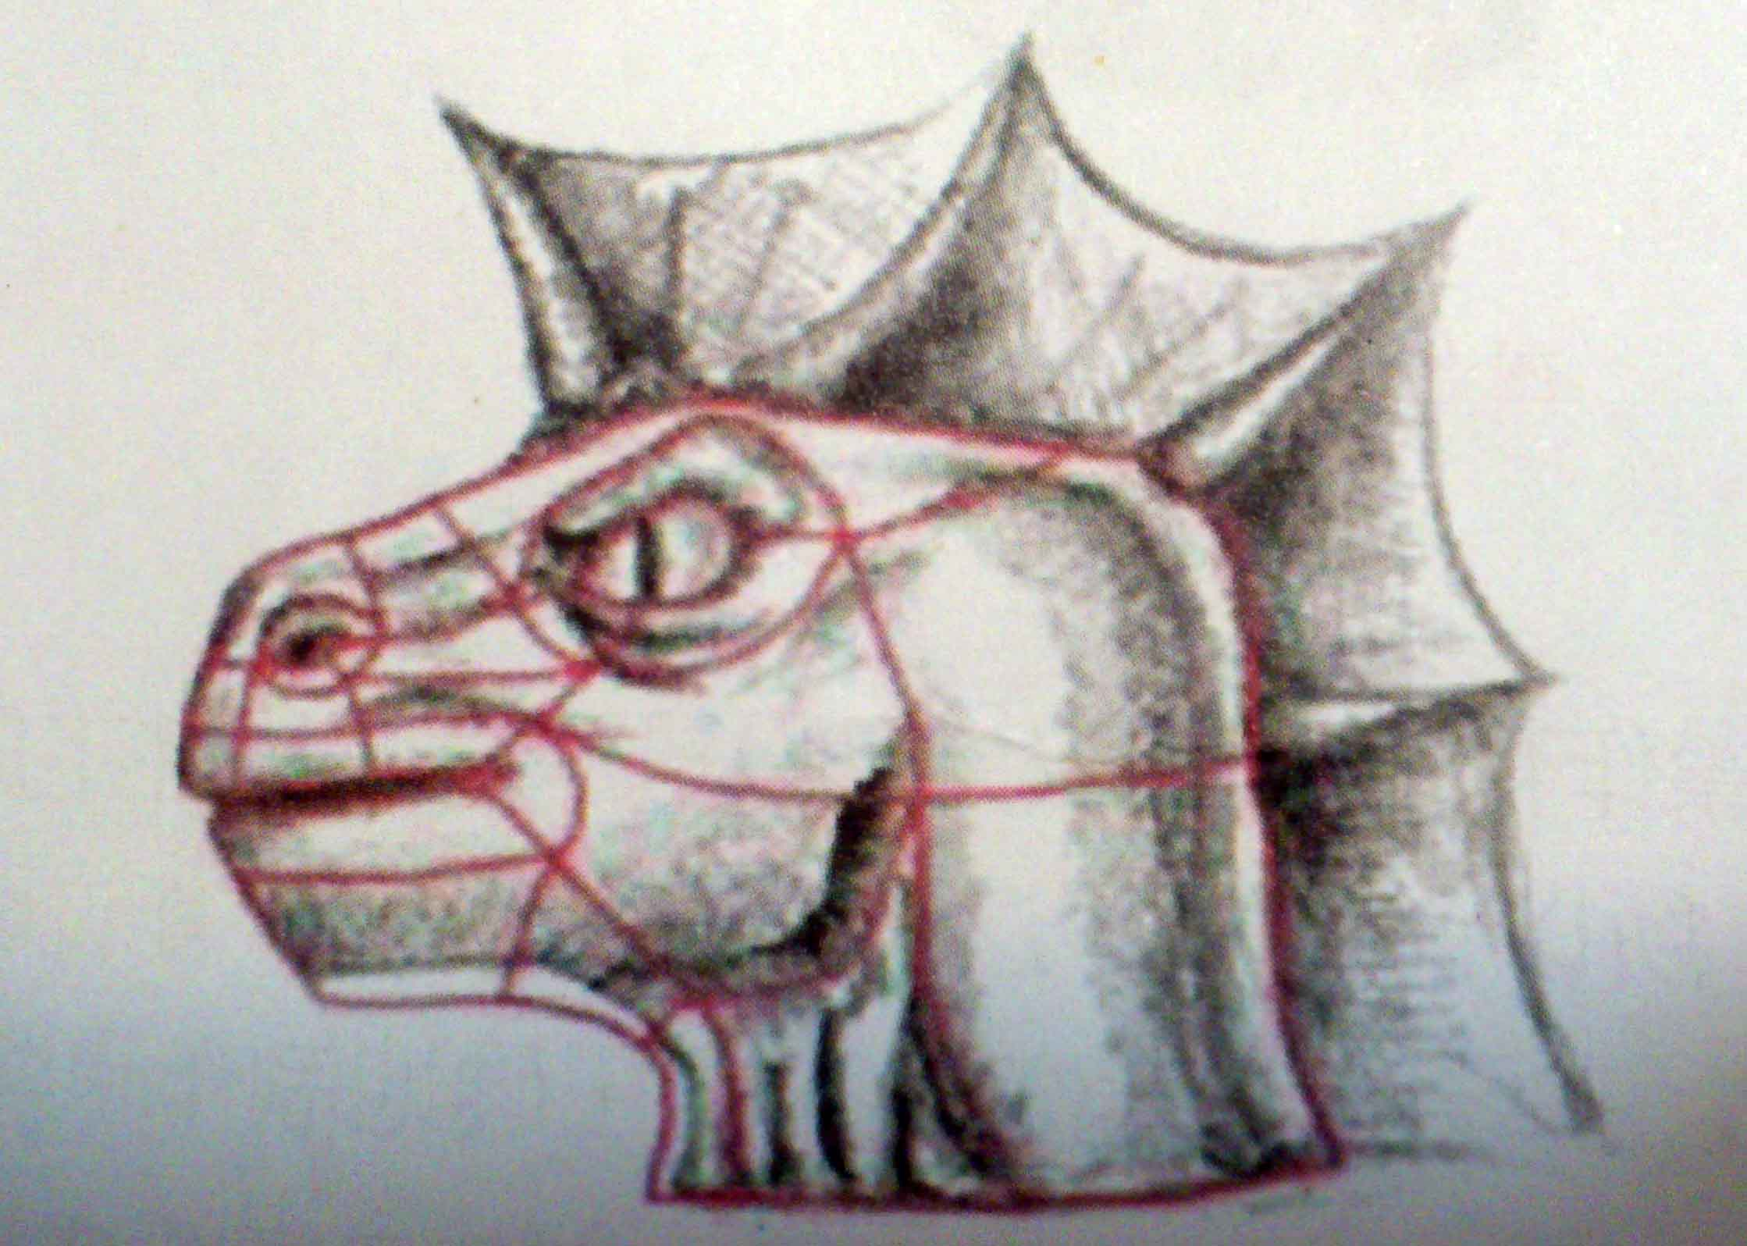
How to envelop?
Step 1：Draw and analyze original drawings, then plan the skin segmentation scheme.

Slide 17
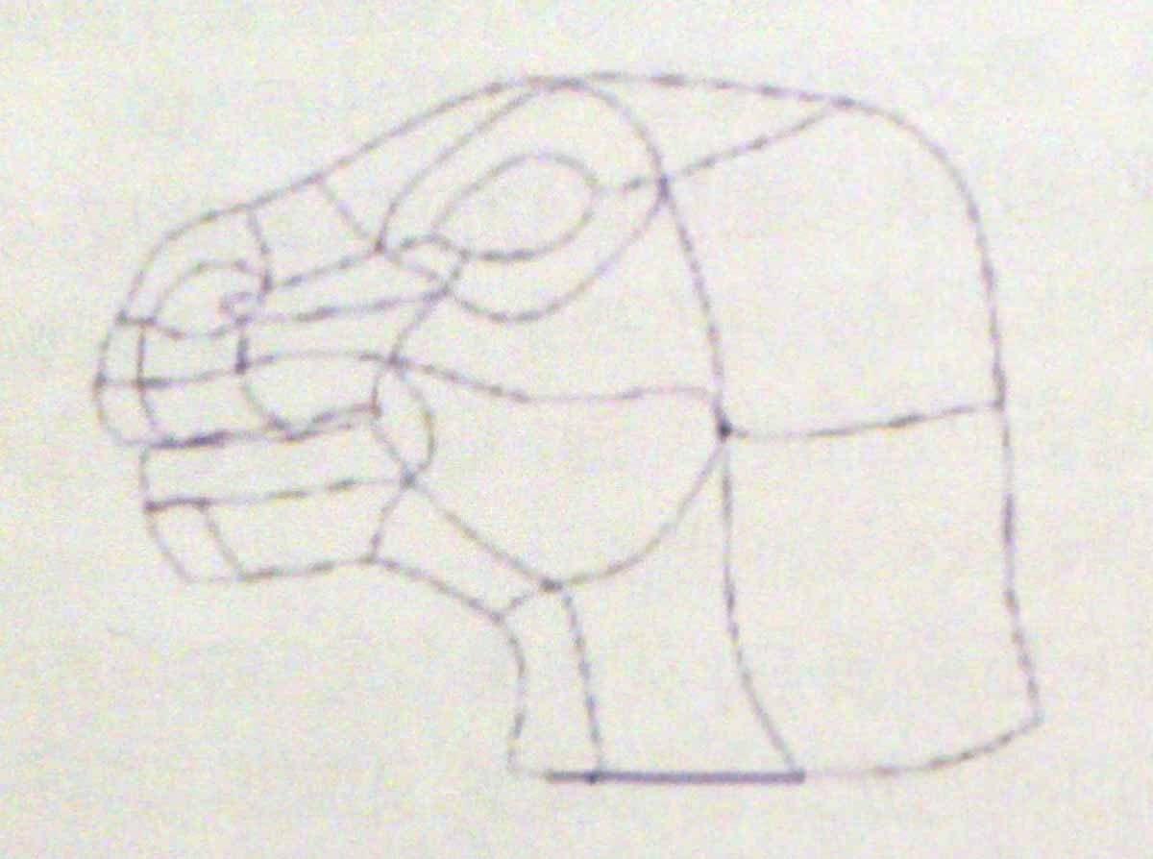
How to envelop?
Step 2：Sketch the contours of lines: Draw interlocking CV curves that make up each group of four.

Slide 18
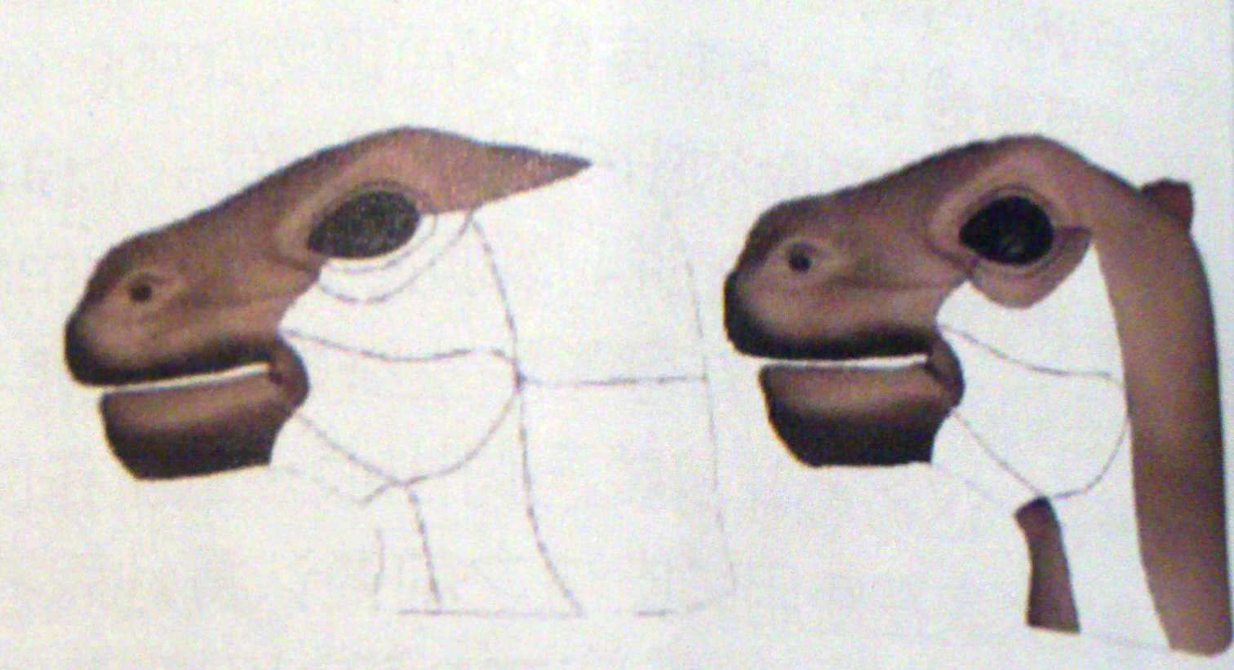
How to envelop?
Step 3：Use curves to create surfaces.

Slide 19
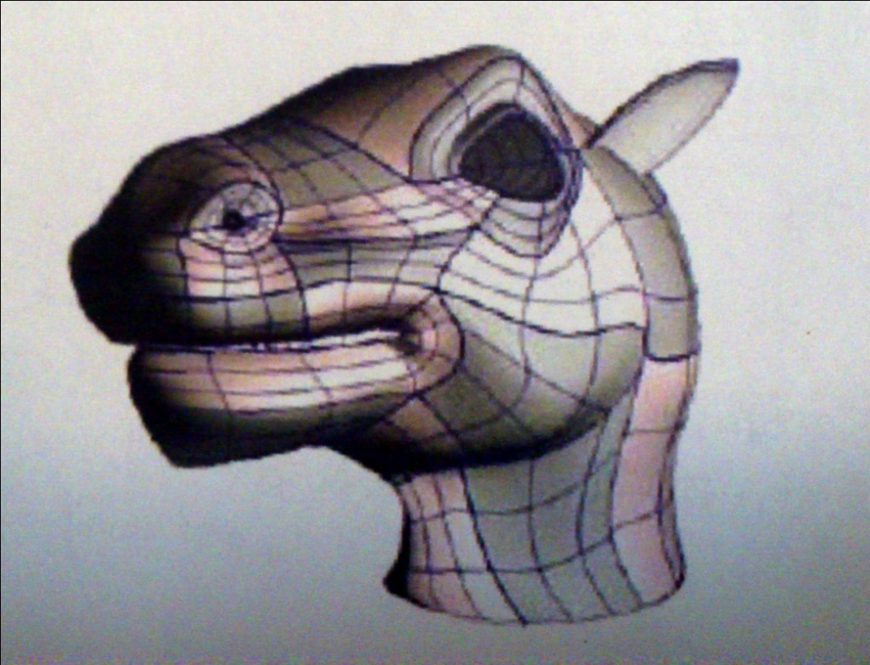
How to envelop?
Step 4：Adjust surfaces to finish models. For the surfaces of the final model are pieced one by one, we need to totally adjust it, including eliminating seams and enhancing continuity of surface, etc., so as to eventually shape the whole model whole and smooth.

Slide 20
Section 3. 3D Animation Modeling Technology
* NURBS
* Polygon
* Subdiv Surfaces

Slide 21
* NURBS
NURBS uses mathematical function to define the curve and surface。
NURBS is based on NURBS curves to create surfaces, and you can just use it to control surfaces, which isn't rendered.
NURBS suits for off-standard model creation, such as human body and car.

Slide 22
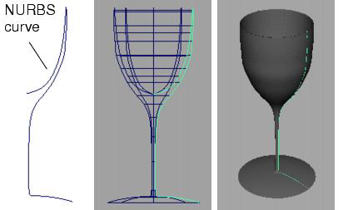

Slide 23
* Polygon
Polygon is based on triangles and quadrangles that join together. We can create everything with enough polygons. But more polygons means more resource comsumption, so we'd better not add details too much unless essential.
All models with polygons is made up of vertices, edges and faces, so we can change that to change the shape of models.
Polygon is suitable for the rule models, such as buildings, scene creation.

Slide 24
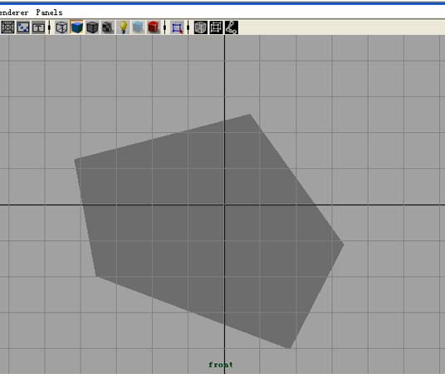
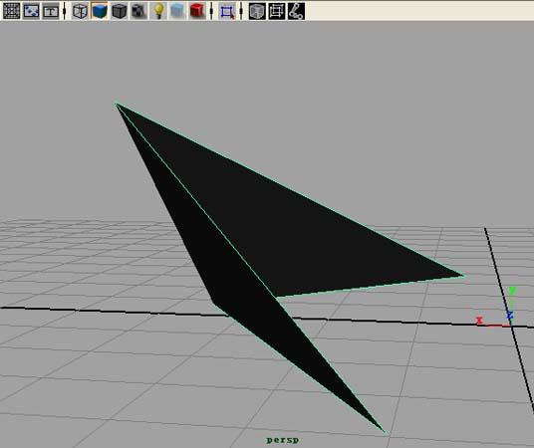

Slide 25
* Subdiv Surface
Subdivision simplifies the production of complex objects due to the combination of the advantages of polygon and Nurbs.
MAYA subdivision turns specific areas of models to more details and controls point forms to control rendering accuracy during rendering like Nurbs, which is a powful upgrade of polygons.

Slide 26
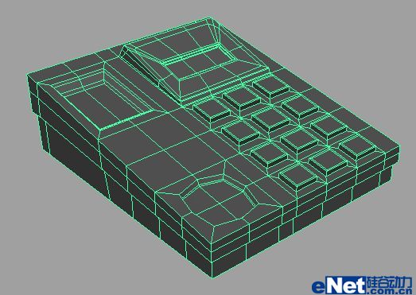
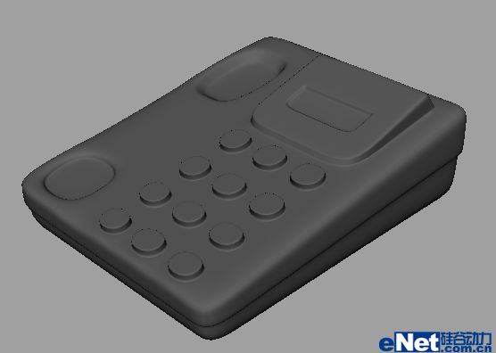

Slide 27
Section 4. Modeling Assistant Tool
* Edit>Delete By Type>History
* Modify>Freeze Transformations
* Display>Object Display>Template

